Slide 1

Intro to Scripture Engagement

Slide 2
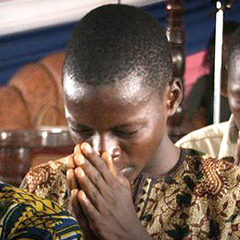
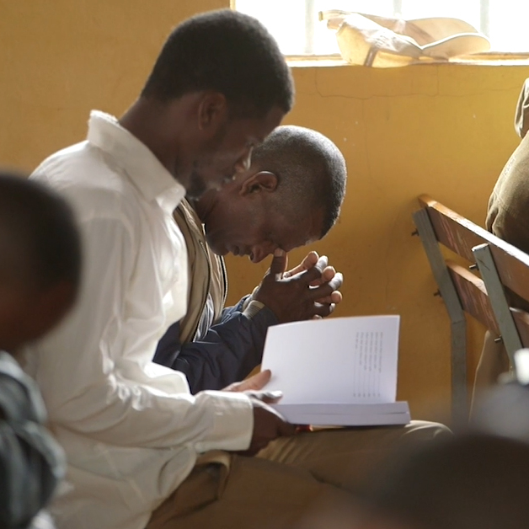

?
At church
How is scripture used in your community?
In Sunday school or small groups
In homes / with children

Slide 3
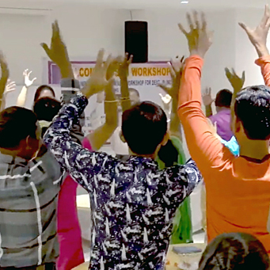
?
Group teaching
Individual teaching
What are some ways that scripture was used in the Bible?
Training and correction
Singing

Slide 4
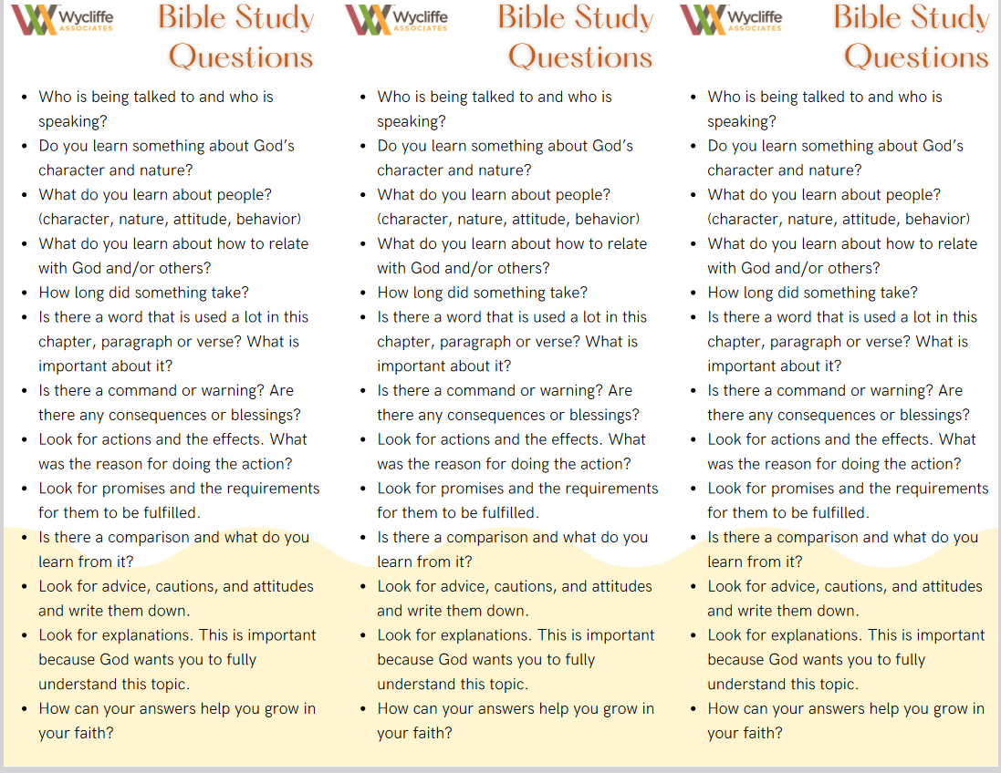
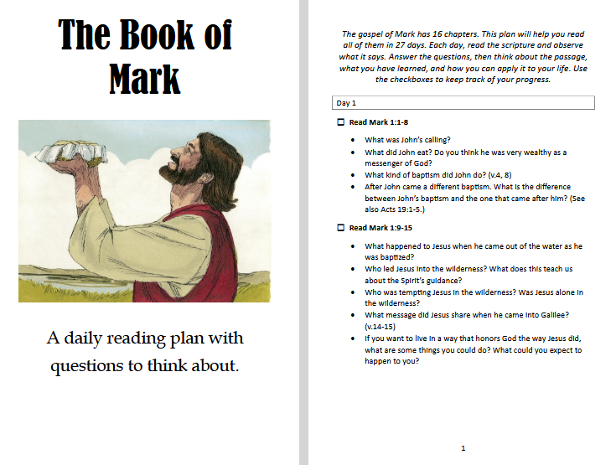

Resources
Devotionals
Bible Studies
Reading plans
Study question
Leader guides
Prayer cards

Slide 5
?
How might your community use the new translation?

Slide 6


